Slide 1
Processing Data in External Storage
Chapter 21
Data Structures and Problem Solving with C++: Walls and Mirrors, Carrano and Henry, © 2013

Slide 2
Contents
A Look at External Storage
Sorting Data in an External File
External Dictionaries
Data Structures and Problem Solving with C++: Walls and Mirrors, Carrano and Henry, © 2013

Slide 3
A Look at External Storage
External storage exists after program execution
Generally, there is more external storage than internal memory
Direct access files are essential for external dictionaries
A file contains records that are organized into blocks
Data Structures and Problem Solving with C++: Walls and Mirrors, Carrano and Henry, © 2013

Slide 4
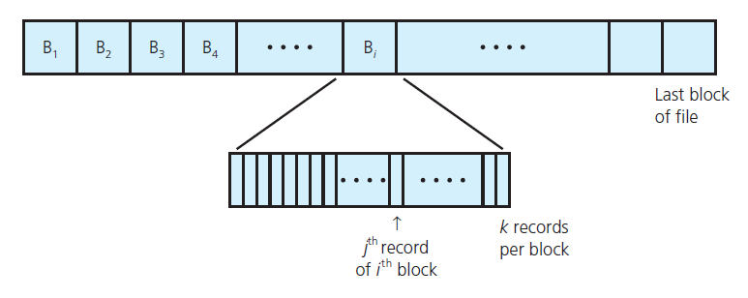
A Look at External Storage
FIGURE 21-2 A file partitioned into blocks of records
Data Structures and Problem Solving with C++: Walls and Mirrors, Carrano and Henry, © 2013

Slide 5


A Look at External Storage
Direct access input and output involves blocks instead of records
A buffer stores data temporarily
Data Structures and Problem Solving with C++: Walls and Mirrors, Carrano and Henry, © 2013

Slide 6

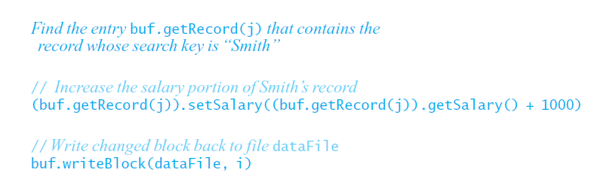
A Look at External Storage
Updating a portion of a record within a block
Data Structures and Problem Solving with C++: Walls and Mirrors, Carrano and Henry, © 2013

Slide 7
A Look at External Storage
Time required to read or write a block of data
  Longer than the time required to operate on the block’s data
  Implication: reduce the number of required block accesses
File access time dominant factor in an algorithm’s efficiency
Data Structures and Problem Solving with C++: Walls and Mirrors, Carrano and Henry, © 2013

Slide 8
Sorting Data in an External File
Example Problem
Fille contains 1,600 employee records
Sorted by Social Security number
Each block contains 100 records
Program can access only enough internal memory to manipulate 3 blocks at a time
Data Structures and Problem Solving with C++: Walls and Mirrors, Carrano and Henry, © 2013

Slide 9
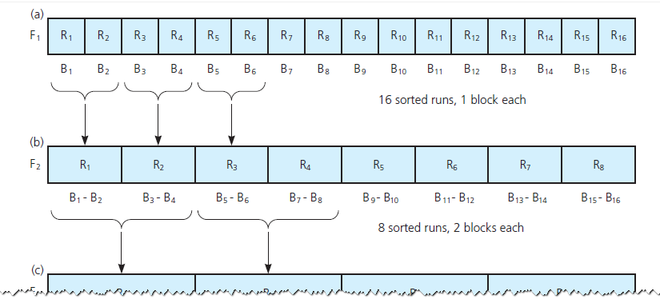
Sorting Data in an External File
FIGURE 21-3 (a) Sixteen sorted runs, one block each, in file F₁ ; (b) Eight sorted runs, two blocks each, in file F₂ ;
Data Structures and Problem Solving with C++: Walls and Mirrors, Carrano and Henry, © 2013

Slide 10
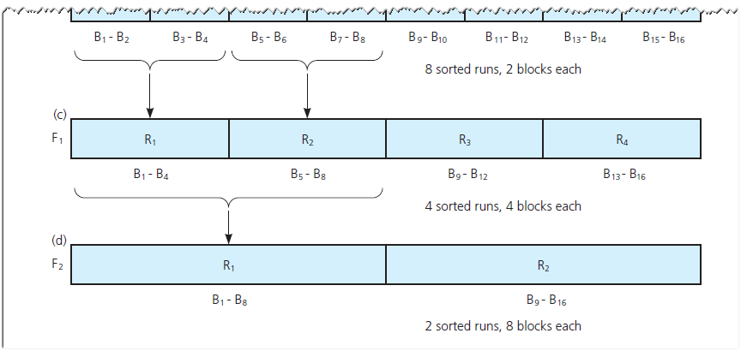
Sorting Data in an External File
FIGURE 21-3 (c) Four sorted runs, four blocks each, in file F₁ ; (d) Two sorted runs, eight blocks each, in file F₂
Data Structures and Problem Solving with C++: Walls and Mirrors, Carrano and Henry, © 2013

Slide 11
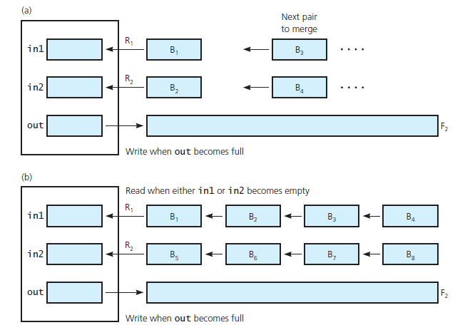
Sorting Data in an External File
FIGURE 21-4 (a) Merging single blocks;
(b) merging long runs
Data Structures and Problem Solving with C++: Walls and Mirrors, Carrano and Henry, © 2013

Slide 12
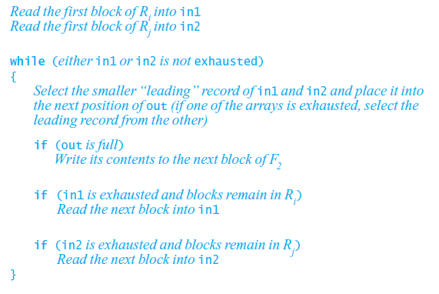
Sorting Data in an External File
Algorithm for merging arbitrary-sized sorted runs
Data Structures and Problem Solving with C++: Walls and Mirrors, Carrano and Henry, © 2013

Slide 13
End
Chapter 21
Data Structures and Problem Solving with C++: Walls and Mirrors, Carrano and Henry, © 2013

